Slide 1
Physics, Clinical Measurement and Equipment for the Final
Sam Beckett
Royal Gwent Hospital

Slide 2
Put your pens down…
All of the information is on the internet!

Slide 3
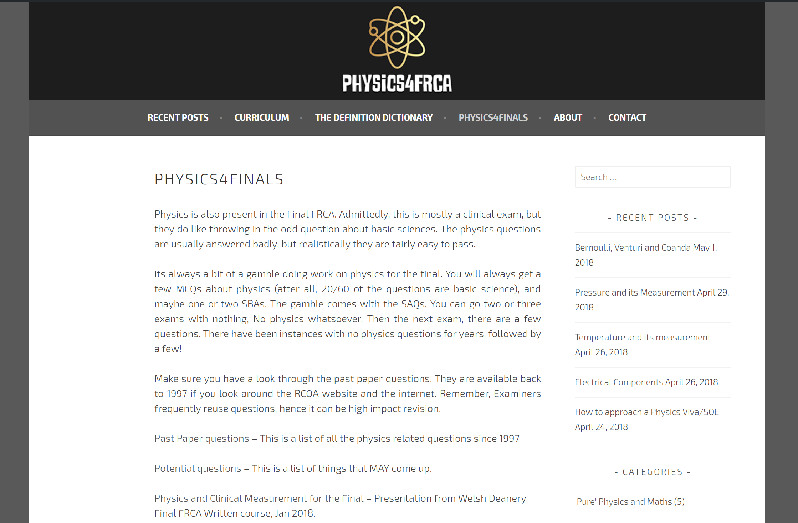
www.physics4frca.com

Slide 4
….Groan….
Isn’t that stuff from the primary?
Frequency
  More often than you think
Calculated risk
  Some exams have no physics/clinical measurement
  Others have 3-4 related questions
Most questions have sections related to physics with a clinically related section.

Slide 5
Why re-learn this stuff?
You already know it from the Primary
Re-learning is quicker than learning!
It’s a relatively small, enclosed section of the curriculum
Potentially high impact, effective revision
Realistically limited options for questions
The average pass mark for a question is ~12/20.
  2-3 marks on a physics related section could turn a borderline into a good pass.

Slide 6
General points
Look at the past papers
Look at the Curriculum
Read the examiners reports
  They give insight into what the examiners are looking for
Guidelines
  AAGBI
  RCOA
  NPSA

Slide 7
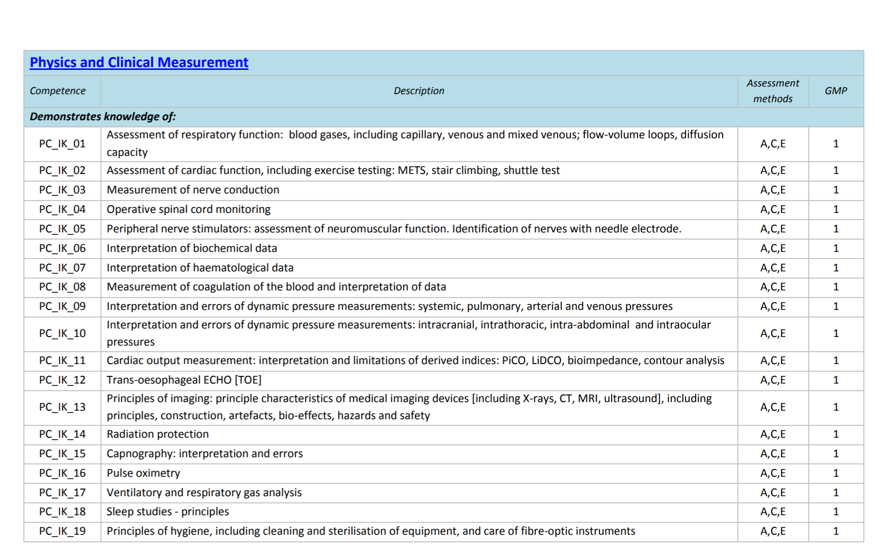












Slide 8
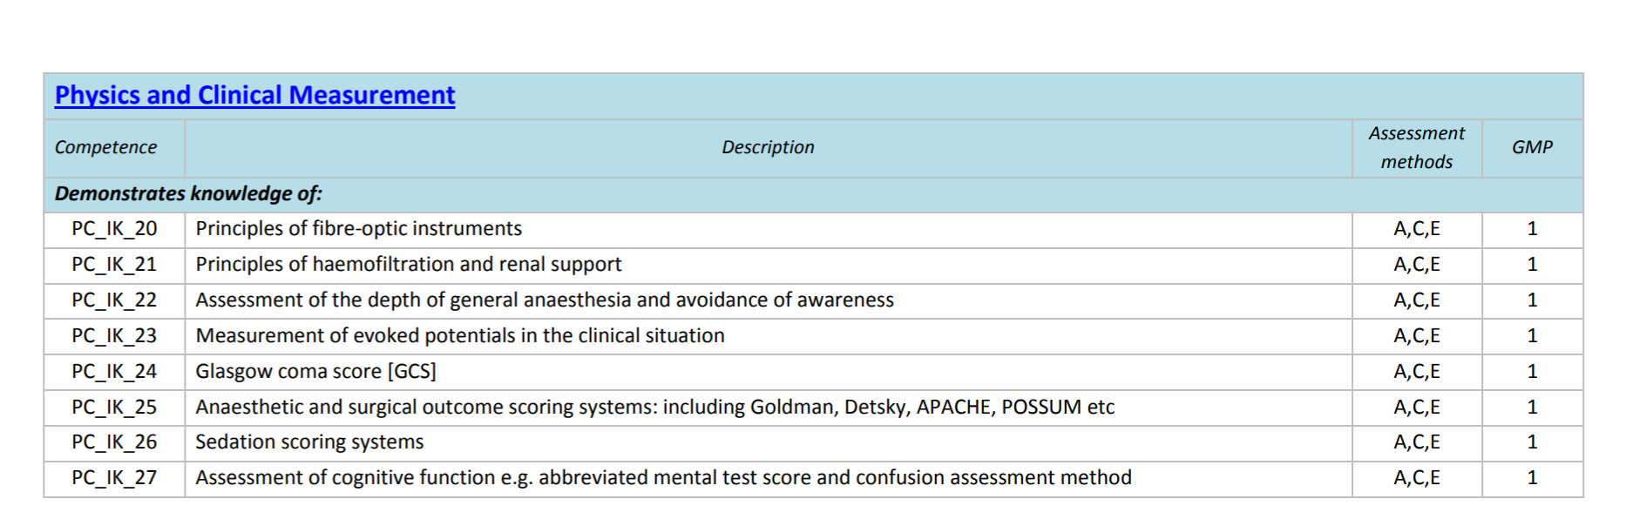





Slide 9
Previous questions
Goes through spells
  Sometimes none, Sometimes a few partial questions, sometimes full questions.
Often repeated questions
Often badly answered, and then repeated with slight modifications
Very little ‘pure’ physics.
Mostly explanations of ‘how things work’ and clinical limitations of equipment.
Any piece of equipment is fair game

Slide 10
What do the examiners look for?
Description of principles
  Usually asking how something works
  Marks are usually for simple points, Don’t overcomplicate it
  Assume the examiners know nothing and start from basics
Complications or limitations of methods
  Again, Nothing complicated.
  You see most of these every time you use them.

Slide 11
Recent topics 1 – March ‘18
Question 3
List the possible indications for the insertion of cardiac implantable electronic devices. (5 marks)
What factors would you check pre-operatively in a patient with these types of devices? (5 marks)
Outline your relevant perioperative management of a patient with an automatic implantable cardioverter-defibrillator (AICD) who is having elective surgery under general anaesthetic. (6 marks)
A patient with a pacemaker develops severe bradycardia with circulatory compromise and no pacemaker response. What specific therapies should you consider in this situation? (4 marks)
Question 11
What are the indications for total intravenous anaesthesia (TIVA)? (7 marks)
What are the main components of a target-controlled infusion (TCI) system? (3 marks)
What are the potential technical problems with TIVA (4 marks) and how might each be prevented? (4 marks)
What are the potential patient complications with this technique? (2 marks)

Slide 12
Recent topics 2 – September ‘17
Question 1 REPEATED
a) What are the indications for renal replacement therapy (RRT) in the intensive care setting? (8 marks)
b) List the types of RRT available in intensive care. (6 marks)
c) Outline the principle mechanisms of solute and water removal by filtration (3 marks) and dialysis (3 marks) during RRT.
Question 3 REPEATED
a) Outline the basic physical principles involved in formation of an ultrasound image. (6 marks)
b) What patient factors (3 marks) and acoustic artefacts (4 marks) may influence the ultrasound image quality?
c) Which two needling techniques are commonly used in ultrasound guided nerve blocks? (2 marks). List the advantages and disadvantages of one of these techniques. (5 marks)
Question 4 REPEATED
a) What is meant by counter pulsation in the context of an intra-aortic balloon pump (IABP)? (1 mark)
b) Briefly explain the effect of counter pulsation from an IABP on coronary blood flow and the left ventricle. (4 marks)
c) What are the indications for (6 marks) and contraindications to (3 marks) the use of an IABP in an adult?
d) List possible complications of an IABP. (6 marks)

Slide 13
Recent topics 3 – March ‘17
Not much!

Slide 14
Recent topics 4 – September ‘16
Question 12
You are asked to transfer an intubated intensive care patient for a magnetic resonance imaging (MRI) scan.
What is meant by the terms magnetic resonance (MR) safe, and MR conditional, in relation to equipment used in the MRI scanner room? (2 marks)
What precautions can be taken to prevent burns caused by monitoring equipment used in an MRI scanner? (6 marks)
List other precautions you would take to minimise the risks associated with MRI. (7 marks)
What are the contraindications to an MRI scan? (5 marks)

Slide 15
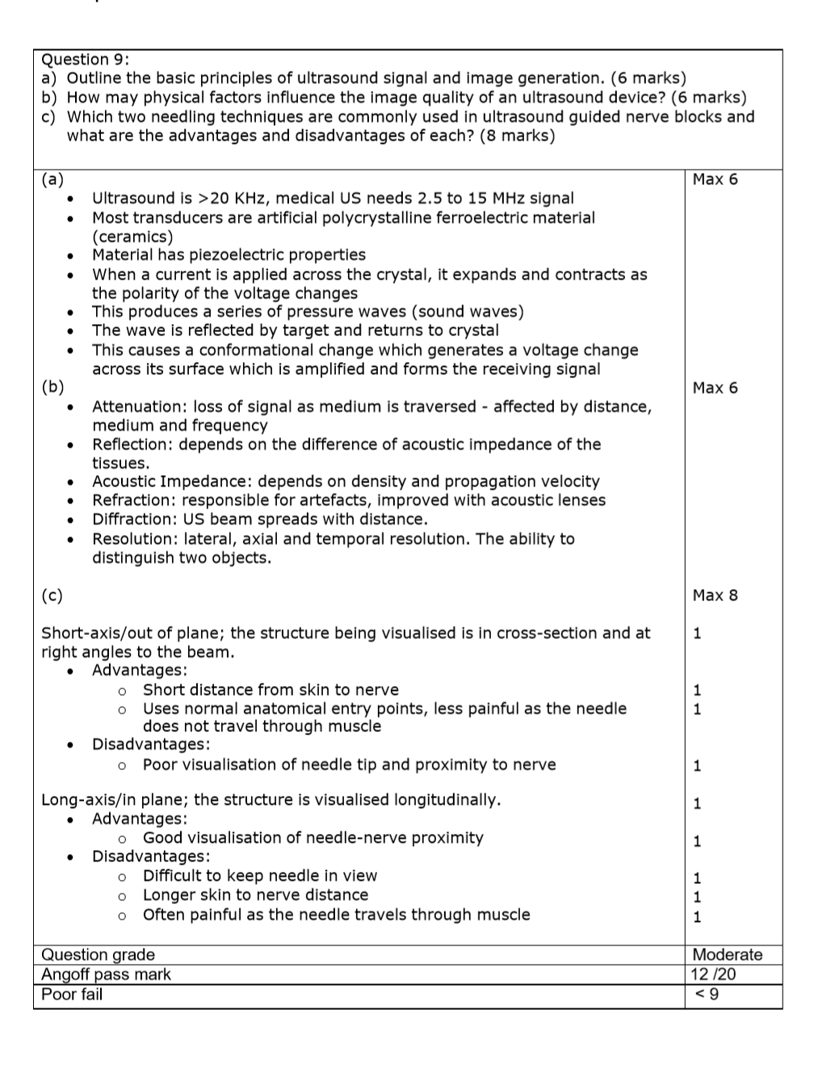
Sneaky?
Reused questions sometimes leave a trace on the internet…
Very slightly modified questions often resurface.

Slide 16
In Depth 1 - Sept 2017
a) Outline the basic physical principles involved in formation of an ultrasound image. (6 marks)
Piezo electric Crystal
Apply electrical current (AC) --> Vibrations --> sound waves
Sound waves travel through tissue and reflect off tissue interfaces
Reflected sound waves cause crystal in transducer to vibrate and create electrical current.
Current interpreted as an image by image processing software.

Slide 17
In Depth 1 - Sept 2017
b) What patient factors (3 marks) and acoustic artefacts (4 marks) may influence the ultrasound image quality?
Patient Factors -
  Obesity (attenuation/depth and frequency)
  Previous surgery/recent surgery
  Oedema (Difficult to see things!)
  Others (air/surgical emphysema, implants etc)
Acoustic Artefacts
  Absorption, Reflection, Diffraction, Refraction….

Slide 18
In Depth 1 - Sept 2017
c) Which two needling techniques are commonly used in ultrasound guided nerve blocks? (2 marks). List the advantages and disadvantages of one of these techniques. (5 marks)
In plane or Out of plane.
In plane advantages – See entire needle (safer!, less likely to damage nerves), allows easy encapsulation of nerve with local anaesthetic.
In plane disadvantages – Longer needle path (more painful), More potential damage to surrounding structures (arguable), can be more difficult to reangle needle. Technical skill of keeping needle in view.

Slide 19
In Depth 2 - Sept 2016
You are asked to transfer an intubated intensive care patient for a magnetic resonance imaging (MRI) scan.
a) What is meant by the terms magnetic resonance (MR) safe, and MR conditional, in relation to equipment used in the MRI scanner room? (2 marks)
MRI Safe - Can enter MRI scanner (but may not function!)
MRI Conditional - Can Enter scanner if specified conditions are met.
MRI Unsafe - Not safe to enter scanner.
** Nothing about function **
Note about MRI Compatible - Old Term, shouldn't be used!

Slide 20
In Depth 2 - Sept 2016
b) What precautions can be taken to prevent burns caused by monitoring equipment used in an MRI scanner? (6 marks)
General – Minimise monitoring used, Minimise metal in contact with patient, Only MRI safe equipment.
ECG - Use of fibre optic or non ferrous ECG probes, Only use conventional leads according to manufacturer's guidance (non ferromagnetic). Place ECG electrodes and leads as close to centre of MRI field as possible
Pulse oximeter - Fibre optic probe.
NIBP - Longer cuff tubing. MRI Safe cuff (metal free), monitor outside MRI field
IBP - Longer tubing, Transducer outside MRI field

Slide 21
In Depth 2 - Sept 2016
c) List other precautions you would take to minimise the risks associated with MRI. (7 marks)
Think laterally - Not just about the MRI itself
Distant anaesthesia - Stable patient, Adequate monitoring, Adequate staff, Adequate emergency drugs and equipment, effective monitoring (but minimise if possible), Staff with previous experience of MRI, Resus equipment location.
Anaesthesia itself - Simple technique, Paralyse and ventilate, MRI compatible equipment
Patient factors – Exclude contraindications (see next section), Is the MRI really needed?, Ear plugs/acoustic shielding
**AAGBI guidelines**

Slide 22
In Depth 2 - Sept 2016
d) What are the contraindications to an MRI scan? (5 marks)
Implantable, non MRI compatible devices (Pacemakers, intrathecal pumps, deep brain/spinal cord stimulators, IABP, Pacing Wires, cochlear implants)
Neurosurgical clips (dependent on brand)
Cardiac stents (dependent on brand/type)
PA catheters/Swan Ganz Catheter
Patient factors (Obesity, Pregnancy?)

Slide 23
In Depth 3: Sept 2015
a) How should you manage the perioperative opioid requirements of a patient who is having elective surgery and who takes regular opioids for non-malignant pain? (8 marks)
b) Give the conversion factors for oral tramadol, codeine and oxycodone to the equianalgesic oral morphine dose. (3 marks)

Slide 24
In Depth 3: Sept 2015
c) What are the perioperative implications of an existing spinal cord stimulator? (6 marks)
Discussion with neurosurgeon/pain team (indications etc)
Avoid monopolar diathermy where possible (avoid electrical path)
Care with neuroaxial block (not contraindicated)
  avoid cable path and implantation site
  Strict asepsis, risk of system infection.
Turn to lowest amplitude & Turn off prior to induction
Postoperative interrogation for damage/failure

Slide 25
In Depth 3: Sept 2015
d) What additional perioperative precautions should be taken if the patient has an intrathecal drug delivery system fitted? (3 marks)
Empty reservoir before surgery (avoid accidental bolus through malfunction)
Turn off prior to surgery
Avoid neuroaxial techniques (?)
Note can access side port on certain pumps to provide spinal anaesthetic**

Slide 26
Possible future topics?
Full list on the internet… But look at the Curriculum!
Cardiac output monitoring
  Never asked (apart from a 10 year old question on Swan Ganz catheters)
  ? PICCO/LiDCO – Link with ITU
    Including Non Invasive modifications?
  ? Oesophogeal Doppler
  ? Thoracic impedence
Depth of anaesthesia monitoring
  BIS
  NAP5 related
  Asked in 2016, but vague on specifics of monitoring of level of consiousness

Slide 27
Possible future topics?
Electrical safety
  Microshock and VF
  Precautions in theatre to reduce chance of this.
Implantable devices
  Pacemakers/ICDs
  Spinal cord and brain stimulators
  Intrathecal pumps
Vaporisers
  Classical Plenum type
  Modern Injection type

Slide 28
Possible future topics?
Look around your anaesthetic room…
What does it do/measure?
  What are the indications for use?
  What information does it give you?
  How do you interpret the information? (remember this is a clinical exam!)
How does it do this?
  How do the inside of it work?
  What are the underlying principles?
  Are there any equations or laws associated with it?
What are its limitations?
  What are the sources of error of the device?
  What increases/decreases the error present?

